Slide 1
Advanced Graphics – Physically Based Rendering
Jainesh Pathak
June 2023
School of Computing Science
Newcastle University
J.P.Pathak2@newcastle.ac.uk

Slide 2
Background
Lighting plays an important role to bring realism in computer graphics. Without it, the digital world will look colourless boring and dull.
2.5D games like Doom introduced “Sector-based” lighting and “Light Diminishing”:
Sector-Based Lighting:
Game level is divided into sectors.
Every sector had a light level with range 0-255. 0 being complete dark and 255 being very bright.
Light Attenuation were done where light levels of neighbour sectors gradually decreases to show light is traveling over distance.
Light Diminishing:
Sector area from player’s point of view is bright enough for player to see and slowly decreases as the distance between area and player increases.
Also used in simulating fog.
As GPUs progressed, lighting and overall video game graphics also progressed.
3D Games like Unreal, Doom 3 showcased more dynamic lighting with different light sources: Point, Directional, Spot Lights.
Blinn-Phong light model became widely popular and used in computer graphics.
Light Terminologies: Diffuse (Refraction) and Specular (Reflection)

Slide 3
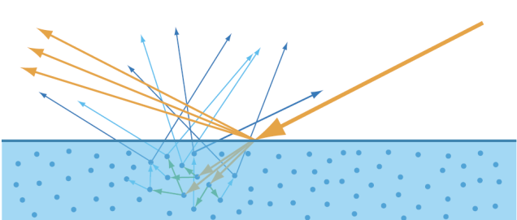
Introduction
Blinn-Phong light model problems:
Violates conservation of energy law. Energy is lost as specular intensity is increased.
Doesn’t take the metallic and roughness surface properties on a microfacet level.
3D Games like Unreal, Doom 3 showcased more dynamic lighting with different light sources: Point, Directional, Spot Lights.
Different graphics API - OpenGL, DirectX introduced shaders and shading language which lets to do lighting, texture animation, etc.
Lighting Model – the behaviour of interactions between surface and light source.
Shading Model – operation of calculating the final colour of a pixel.
Two types of light interactions: Diffuse (Refraction) and Specular (Reflection)
Diffuse: Light gets refracted into the surface and moves out after several bounces.
Specular: Light gets reflected.

Slide 4
Implementation and Challenges

